Slide 1
Buying a House in Toronto
Applied Data Science Capstone
Miranda Basha

Slide 2
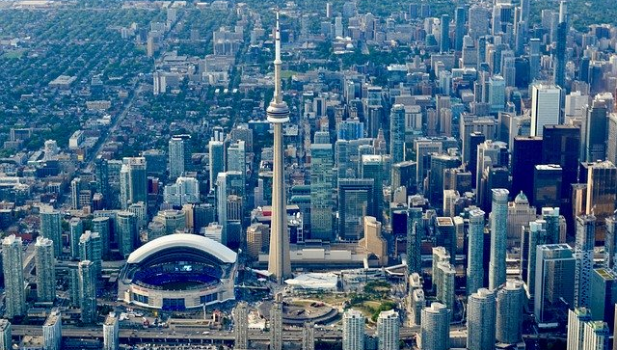

Slide 3
Introduction
Part 1: Problem Description
With house prices rising in Toronto, it is becoming very difficult to take such a big step as to buying a home in Toronto. Someone that is looking to take this big step has to look into many factors: price, safety, amenities, schools... just to name very few. Navigating through this myriad of factors is a daunting task. The proposed solution helps prospective home buyers in Toronto by providing information about prices, amenities and school ratings.

Slide 4
Data
Part 2: Data We Need
For the Toronto neighborhood data, we'll be using the Wikipedia page that has all the information we need to explore and cluster the neighborhoods in Toronto. The page will be scraped, wrangled, cleaned, and then read it into a pandas dataframe so that it is in a structured. The main features from this dataset that will be used are the postal code and administrative districts (boroughs).

Slide 5
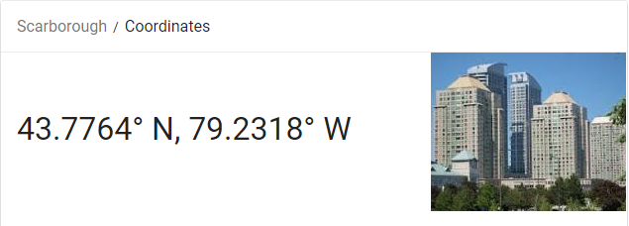
Data
Part 2: Data We Need
We'll use Foursquare to find 5 top amenities per postal code and will attach this data to the dataframe containing neighborhood data (from Step a)

Slide 6
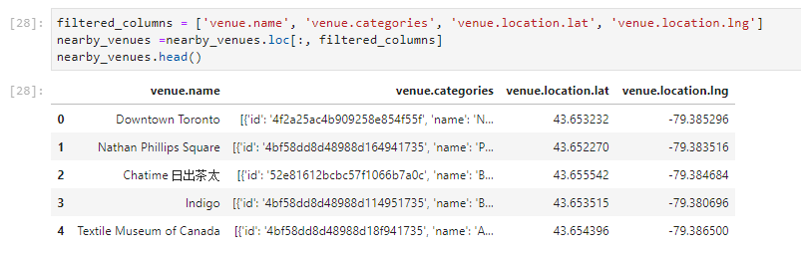
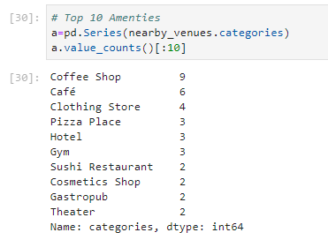
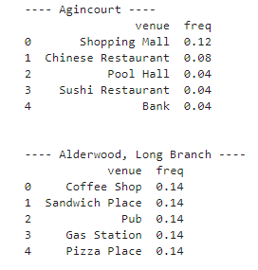
Synopsis
Part 2: Data We Need
b) Cont’d

Slide 7
Data
Part 2: Data We Need
For the Toronto neighborhood data, we’ll use the average price information per postal code. Since this information is not readily available, we embedded this info into the code; it was extracted from realtor.ca using different postal codes in Toronto. This data is used to join it with neighborhood data in order to use it for our analysis.

Slide 8
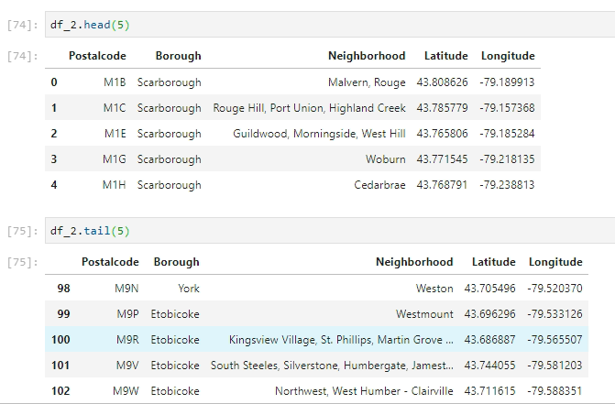
Main Article
Part 1: Identifying Postal Codes and neighborhoods in Toronto

Slide 9
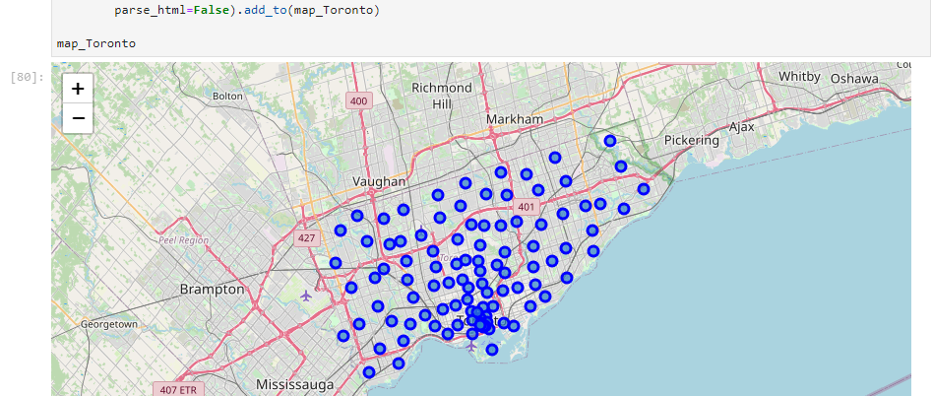
Main Article
Part 1: Identifying Postal Codes and neighborhoods in Toronto

Slide 10
Main Article
Part 2: Connecting to Foursquare and Retrieving Locational Data for Each Venue in Every neighborhood
After finding the list of neighborhoods, we then connect to the Foursquare API to gather information about venues inside each and every neighborhood. For each neighborhood, we have chosen the radius to be 1000 meter. It means that we have asked Foursquare to find venues that are at most 1000 meter far from the center of the neighborhood.

Slide 11
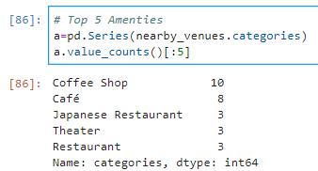
Main Article
Part 2: Connecting to Foursquare and Retrieving Locational Data for Each Venue in every neighborhood

Slide 12
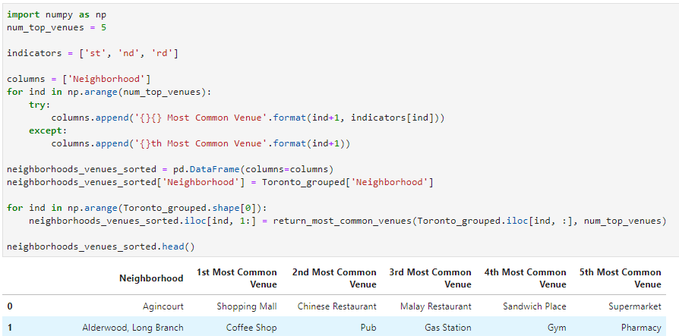
Main Article
Part 2: Finding 5 most common venues per neighborhood

Slide 13
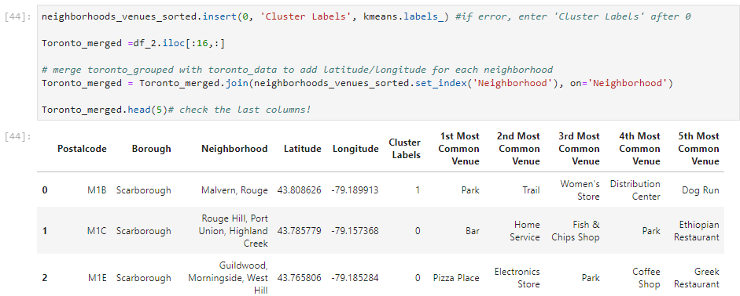
Main Article
Part 3: Processing the Retrieved Data for all neighborhoods and creating a DataFrame for 5 most common venues for each neighborhood

Slide 14
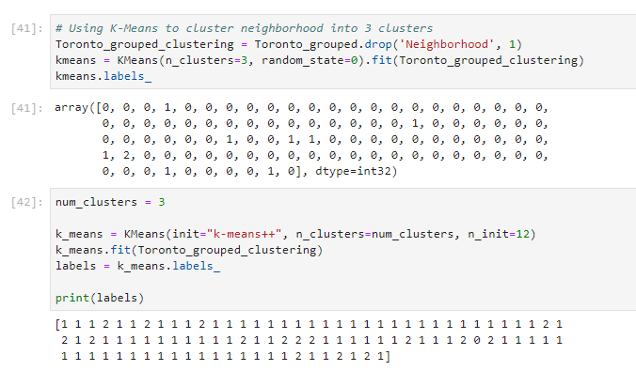
Main Article
Part 4: Cluster neighborhoods into 3 clusters using K-Means

Slide 15
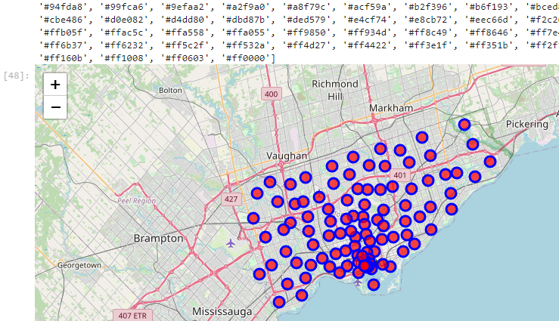
Now, the dataset is fully ready to be used for machine learning (and statistical analysis) purposes.
Part 4: Mapping all clusters

Slide 16
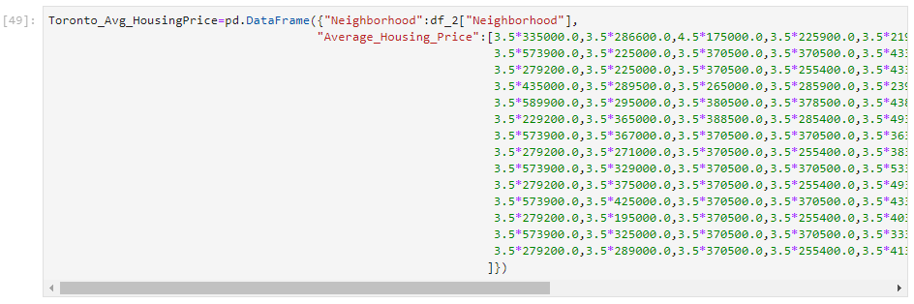
Main Article
Part 4: Loading average house prices by neighborhood

Slide 17
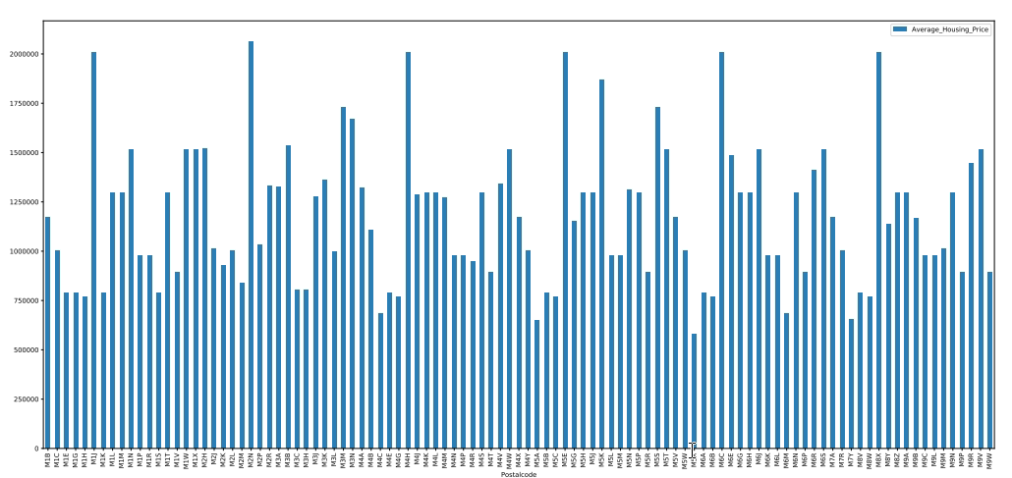
Main Article
Part 4: Applying one of Machine Learning Techniques (Plotting K-Means Clustering by Postal Codes)

Slide 18
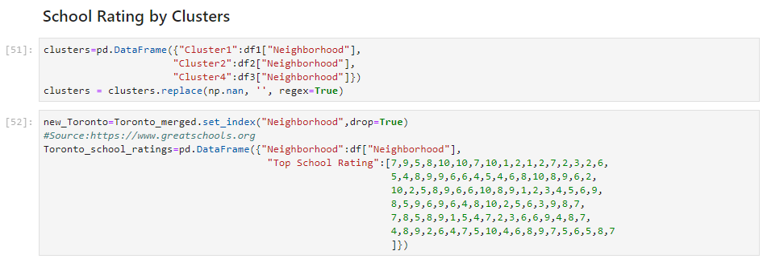
Main Article
Part 4: Loading school ratings by neighborhood

Slide 19

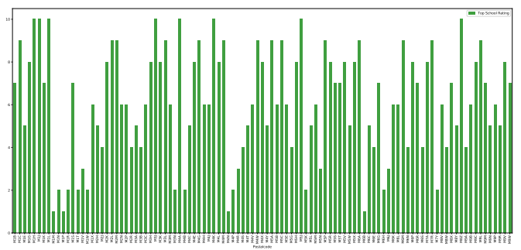
Main Article
Part 4: Applying one of Machine Learning Techniques (Plotting school ratings by Postal Codes)

Slide 20
THANK YOU

